Slide 1
Event Handling, Toast Notification, and AlertDialog
Sulaxan Jadhav

Slide 2
Agendas
Module 1: Introduction to Event Handling
Module 2: Toast Notifications
Module 3: AlertDialog

Slide 3
Module 1: Introduction to Event Handling - Agenda
What is Event Handling?
Understanding Event Listeners and Handlers
Implementing Event Listeners
Advanced Event Handling Techniques
Hands-On Exercise 1

Slide 4
Definition of Event Handling in Mobile Development
Event Handling in mobile development refers to the process by which an application responds to user interactions and system triggers.
Events are actions or occurrences that can happen as a result of user input (such as a button click or a screen swipe) or system changes (like receiving a text message or a change in network connectivity).
When an event occurs, the mobile application must recognize and respond to it appropriately. This process is managed through event handling, which typically involves:
Event Detection: Recognizing that an event has occurred.
Event Listener: A component that waits for an event to occur and triggers a corresponding action when the event happens.
Event Handler: The method or function that executes in response to the event.
For example, when a user taps a button in an Android app, the app detects this action as an event. An event listener, like OnClickListener, listens for this tap, and an event handler executes the code associated with this listener.

Slide 5
2. Importance of Event Handling
User Interaction:
Mobile apps are primarily driven by user interactions.
Without event handling, an app cannot respond to user inputs like taps, swipes, or key presses.
This makes event handling fundamental to providing a smooth user experience.
Dynamic Response:
Event handling allows apps to react dynamically to both user actions and system changes.
For example, an app can adjust its UI in response to different screen orientations or manage resources when the battery is low.

Slide 6
Efficient Resource Management:
By handling system events like low memory warnings, developers can manage resources effectively, ensuring the app runs smoothly without crashing.
Enabling Complex Interactions:
Event handling enables complex interactions within an app, such as dragging items, performing gestures, or multi-touch operations.
These interactions are essential for modern mobile apps, especially in games and multimedia applications.
Ensuring Accessibility:
Proper event handling ensures that an app is accessible to all users, including those who rely on assistive technologies.
By handling events properly, developers can make sure that all users can interact with the app effectively.

Slide 7
3. Types of Events in Mobile Development
Event handling in mobile development can be broadly categorized into two types: User-initiated Events and System-initiated Events.
A. User-initiated Events
Touch
Key
Gesture
B. System-initiated Events
Lifecycle Events:
Network Events:
Resource Events:
Sensor

Slide 8
A. User-initiated Events
Touch Events:
Tap/Click: The most common user-initiated event, where a user taps on the screen or clicks a button. This can be captured using an OnClickListener.
Long Press: When a user presses and holds a point on the screen. This event can trigger additional options or actions, often used in context menus.
Swipe: A quick horizontal or vertical movement on the screen, often used for navigation (e.g., swiping between tabs).
Drag and Drop: Moving an item across the screen by dragging it with a finger, used in apps that allow reordering or moving objects.
Pinch and Zoom: A multi-touch gesture where two fingers are used to zoom in or out on content.

Slide 9
Key Events:
Key Press: Handling physical or virtual keyboard inputs, such as typing in a text field.
Key Long Press: Similar to touch long press, but triggered by holding a key down.
Gesture Events:
Double Tap: Two quick taps on the screen, often used to zoom in on content.
Fling: A rapid swipe that often triggers a quick scroll or a navigation action.

Slide 10
Lifecycle Events:
Activity Lifecycle Events: Events like onCreate, onStart, onResume, onPause, onStop, and onDestroy are triggered as the activity moves through its lifecycle stages. Handling these events is critical for managing resources and saving/restoring UI states.
Network Events:
Network Connectivity Changes: Handling events related to the device's network status, such as detecting when the device goes offline or reconnects to a network.
Broadcast Receivers: Listening for system-wide broadcast announcements like incoming calls, SMS, battery status changes, or connectivity changes.

Slide 11
Resource Events:
Low Memory: Triggered when the system is running low on memory, prompting the app to release unused resources or reduce memory usage.
Battery Low: When the battery level is critically low, the app can respond by reducing energy-consuming operations.
Configuration Changes: Events triggered by changes in the device’s configuration, such as screen orientation changes, locale changes, or screen size adjustments.
Sensor Events:
Motion Detection: Triggered by the device's accelerometer, gyroscope, or other motion sensors. For example, an app might react when the user shakes the device.
Proximity Events: Detected by the proximity sensor, often used to turn off the screen when the device is held close to the face during a call.

Slide 12
Understanding Event Listeners and Handlers in Android

Slide 13
1. Introduction to Event Listeners in Android
Definition: An event listener is an interface that receives event notifications. An event handler is a method or function that is called when the event occurs.
Importance: Event listeners are essential in making the application interactive and responsive. Without them, the app cannot respond to user actions, making the app static and less user-friendly.
Common Event Listeners in Android:
OnClickListener: Used to detect click events, typically on buttons or clickable views.
OnLongClickListener: Used to detect a long press on a view.
OnTouchListener: Used to detect touch events, which can include a variety of gestures like tapping, swiping, and dragging.
OnFocusChangeListener: Used to detect when a view gains or loses focus.
OnKeyListener: Used to detect key events from the physical or virtual keyboard.
OnGestureListener: Part of the GestureDetector class, used to handle complex gestures like flings or double-tap.

Slide 14
2. Implementing Common Event Listeners

Slide 15
OnClickListener
Usage: The OnClickListener interface is the most commonly used listener in Android. It is typically used to handle click events on buttons, text views, images, etc.
Button button = findViewById(R.id.button);
button.setOnClickListener(new View.OnClickListener() {
@Override
public void onClick(View v) {
// Handle the button click
Toast.makeText(getApplicationContext(), "Button Clicked!", Toast.LENGTH_SHORT).show();
}
});

Slide 16
OnLongClickListener
Usage: The OnLongClickListener is used to handle long press events on a view. This is useful for showing context menus or triggering alternative actions.
button.setOnLongClickListener(new View.OnLongClickListener() {
@Override
public boolean onLongClick(View v) {
// Handle long click event
Toast.makeText(getApplicationContext(), "Button Long Pressed!", Toast.LENGTH_SHORT).show();
return true; // Return true if the event is consumed
}
});

Slide 17
OnTouchListener
Usage: The OnTouchListener is more versatile and can detect various touch events like ACTION_DOWN, ACTION_MOVE, and ACTION_UP, which form the basis for gestures like swipes and drags.

Slide 18
OnFocusChangeListener and OnKeyListener
Usage:
OnFocusChangeListener detects when a view gains or loses focus, useful for form validation.
OnKeyListener detects key events, which is essential for apps that require keyboard input handling.

Slide 19
3. Event Handlers and Their Role in Managing User Actions
An event handler is the function or method that is called when a specific event occurs.
Event handlers are where the business logic is executed in response to user or system events.
Definition: An event handler is a callback method that is invoked when an event is triggered. For example, in the case of a button click, the onClick(View v) method is the event handler.
Role and Importance:
Execution of Business Logic: Event handlers contain the code that defines what happens when an event occurs. For example, navigating to a new screen, displaying a message, or processing user input.
UI Updates: Event handlers are often responsible for updating the UI in response to user actions. This can include showing or hiding elements, changing colors, or updating text.
Data Processing: Event handlers may also perform backend operations like making network requests, processing data, or interacting with databases.
User Feedback: Providing immediate feedback through event handlers (such as showing Toast messages or Snackbar notifications) is crucial for a responsive user experience.

Slide 20
4. Best Practices for Implementing Event Listeners and Handlers
Keep Event Handlers Short and Focused: Avoid putting too much logic in event handlers. Delegate complex tasks to separate methods or classes to maintain code readability and manageability.
Avoid Memory Leaks: Ensure listeners are properly detached or removed to avoid memory leaks, especially in cases of anonymous inner classes.
Use Lambdas for Conciseness: If using Java 8 or Kotlin, leverage lambda expressions to reduce boilerplate code for event listeners.
Consider Accessibility: Ensure that event handling does not affect accessibility. For example, adding onClick handlers should not override keyboard navigation.

Slide 21
Advanced Event Handling Techniques in Android
1. Introduction to Gesture Detection
Gestures are a form of user interaction that involves various touch-based actions, such as swiping, pinching, double-tapping, etc. Understanding how to handle these gestures is crucial for creating intuitive and responsive mobile applications.
Common Gestures in Android:
Tap: A quick touch on the screen.
Double Tap: Two quick touches on the screen.
Swipe: A quick movement in a direction (left, right, up, down).
Pinch and Zoom: Two fingers moving apart (zoom in) or together (zoom out).
Long Press: A touch and hold action.
These gestures are typically detected using the GestureDetector and MotionEvent classes in Android.

Slide 22
Importance of Gesture Detection
Improved User Experience: Gestures allow users to perform actions more naturally and fluidly, making the app more intuitive and easy to use.
Efficiency: Users can quickly access functions through simple gestures instead of navigating through multiple menus or buttons.
Accessibility: Gestures can be tailored for users with different needs, providing a more accessible and inclusive experience.
Enhanced Interactivity: Gestures enable a more interactive experience, which can increase user engagement and retention.

Slide 23
Common Gestures in Android
Tap:
A tap is a quick touch on the screen.
This is the most basic form of interaction and is used to select an item, click a button, or interact with any UI component.
It triggers a single event, such as opening a new screen or showing more information.
Double Tap:
A double tap involves two quick touches on the screen.
It is often used for actions like zooming into an image or toggling a state (e.g., double-tapping a map to zoom in).
It requires careful handling to avoid conflict with the single tap gesture.

Slide 24
Swipe:
A swipe is a quick movement in a specific direction—left, right, up, or down.
Swipes are often used to navigate between pages or screens (e.g., swiping between different tabs in an app).
They can also trigger specific actions, such as deleting an item from a list.
Pinch and Zoom:
This gesture involves two fingers moving apart (zoom in) or together (zoom out) on the screen.
It is commonly used for scaling content, such as zooming in and out of maps, images, or documents.
It requires multi-touch detection and often involves using the ScaleGestureDetector in Android.

Slide 25
Long Press:
A long press involves touching and holding a part of the screen for a certain duration.
It is often used to display a context menu, initiate drag-and-drop actions, or select multiple items in a list.
The duration of the press is typically customizable.

Slide 26
Gesture Detection in Android Using GestureDetector and MotionEvent
GestureDetector Class:
The GestureDetector class simplifies detecting various common gestures by providing callbacks for each gesture type (e.g., onSingleTapConfirmed, onDoubleTap, onFling).
It is commonly used to detect gestures such as taps, double taps, long presses, and swipes.
MotionEvent Class:
The MotionEvent class captures all touch events on the screen and provides details like the position, pressure, and size of the touch.
It serves as the foundation for detecting any touch-based gesture, including multi-touch gestures like pinch and zoom.

Slide 27
1. MotionEvent Class
The MotionEvent class in Android represents a touch event. It is the foundation of all touch-related interactions on the screen. Each time a user touches the screen, a MotionEvent object is generated, containing detailed information about the touch action, such as its position, time, type, pressure, and more.
Key Features of MotionEvent Class:
Touch Events: The MotionEvent class captures all kinds of touch events, including finger presses, movements, releases, and multi-touch gestures.
Detailed Information: It provides comprehensive information about each touch event, such as:
Action Type: Determines the type of action, such as ACTION_DOWN, ACTION_MOVE, ACTION_UP, ACTION_CANCEL, etc.
Coordinates: X and Y coordinates of the touch point relative to the view or screen.
Pointer Index: Useful for multi-touch events, identifying which finger is touching or moving.
Pressure and Size: Measures the pressure and size of the touch point.

Slide 28
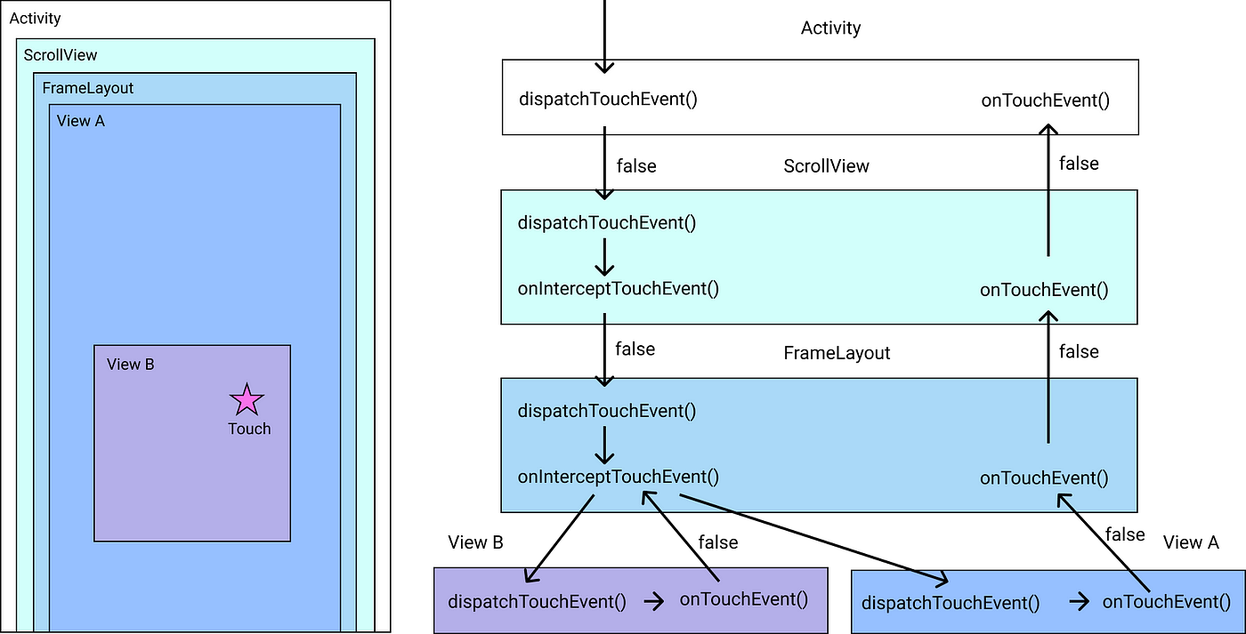

Slide 29
Common MotionEvent Methods:
getAction(): Returns the kind of action being performed (e.g., ACTION_DOWN, ACTION_UP).
getX() and getY(): Returns the X and Y coordinates of the touch point on the screen.
getPointerCount(): Returns the number of pointers (fingers) involved in the current event.
getPointerId(int index): Returns the unique identifier for a pointer (finger) involved in the current event.
getPressure(): Returns the pressure of the touch event, which can be used for more precise control in certain applications.
getSize(): Returns the size of the touch event area; useful in distinguishing between light and firm touches.

Slide 30
2. GestureDetector Class
The GestureDetector class is a high-level utility class in Android that simplifies detecting common gestures and gestures’ sequences, such as taps, double taps, flings, long presses, and more. It leverages the MotionEvent data to detect these gestures and provides convenient callback methods that developers can override to handle them.
Key Features of GestureDetector Class:
Simplifies Gesture Detection: The GestureDetector class provides ready-to-use methods for detecting complex gestures, saving developers from writing custom logic to detect gestures manually.
Callbacks for Common Gestures: Developers can override several callback methods to respond to various gestures like single tap, double tap, long press, fling, etc.
Custom Gesture Detection: While GestureDetector handles common gestures, developers can extend its functionality for custom gestures by using the onTouchEvent(MotionEvent event) method.

Slide 31
Common GestureDetector Callbacks:
onDown(MotionEvent e): Called when a user first touches the screen; usually, it should return true to indicate that subsequent events should be considered.
onShowPress(MotionEvent e): Called when a user touches the screen and has not yet released or moved, indicating a potential long press.
onSingleTapUp(MotionEvent e): Called when a single tap is confirmed.
onLongPress(MotionEvent e): Called when a user performs a long press gesture on the screen.
onScroll(MotionEvent e1, MotionEvent e2, float distanceX, float distanceY): Called when a user scrolls (drags their finger) on the screen.
onFling(MotionEvent e1, MotionEvent e2, float velocityX, float velocityY): Called when a user performs a fling (quick swipe) gesture on the screen.
onDoubleTap(MotionEvent e): Called when a double-tap gesture is detected.
onDoubleTapEvent(MotionEvent e): Called when any specific event within a double-tap gesture occurs (e.g., the second tap in a double tap).
onSingleTapConfirmed(MotionEvent e): Called when a single tap has been confirmed to be a single tap and not a double tap.

Slide 32
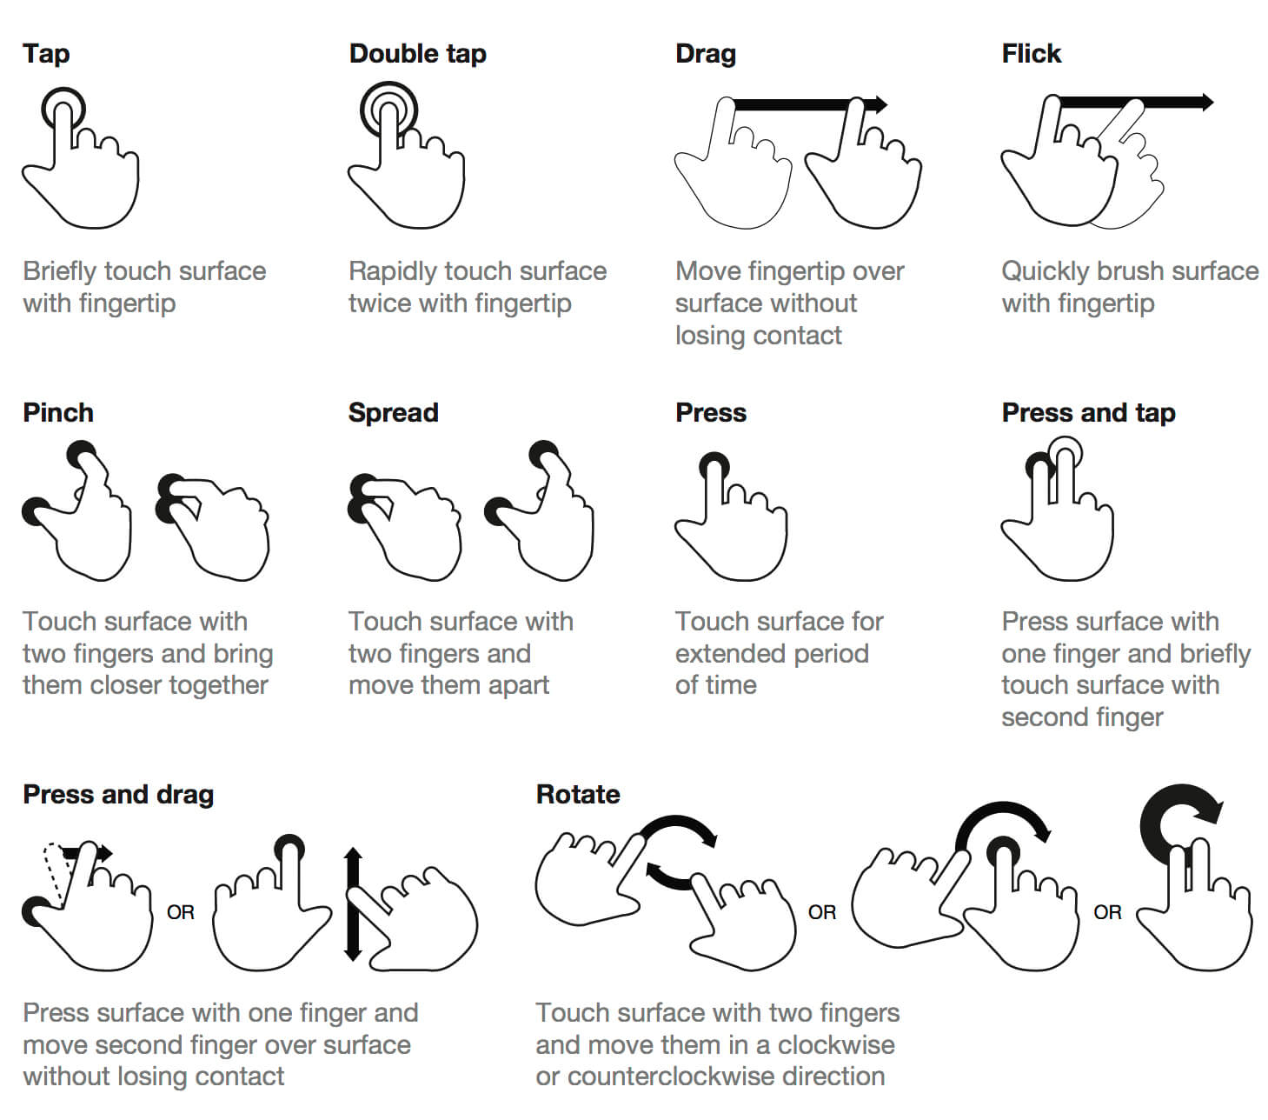

Slide 33
3. How GestureDetector and MotionEvent Work Together
The GestureDetector works by analyzing the sequence of MotionEvent objects that correspond to a user's touch sequence. For example, a swipe gesture would involve a MotionEvent.ACTION_DOWN followed by a series of MotionEvent.ACTION_MOVE events, and then a MotionEvent.ACTION_UP.
GestureDetector uses these MotionEvent objects to determine what gesture was performed and then triggers the appropriate callback method.
By overriding the methods provided by GestureDetector, developers can specify what actions should be performed when a gesture is detected.

